Slide 1
Distance Vector Routing
Computer networks generally use dynamic routing algorithms that are more complex than flooding, but more efficient because they find shortest paths for the current topology.
Two dynamic algorithms in particular, Distance vector routing and Link state routing are the most popular.
The distance vector routing algorithm is sometimes called by other names, most commonly the distributed Bellman-Ford routing algorithm, after the researchers who developed it (Bellman, 1957; and Ford and Fulkerson, 1962).
It was the original ( Advanced Research Projects Agency Network) ARPANET routing algorithm and was also used in the Internet under the name RIP.
A distance vector routing algorithm operates by having each router maintain a table (i.e., a vector) giving the best known distance to each destination and which link to use to get there. These tables are updated by exchanging information with the neighbors.
Eventually, every router knows the best link to reach each destination.

Slide 2
Distance Vector Routing
In distance vector routing, each router maintains a routing table indexed by, and containing one entry for each router in the network.
This entry has two parts: the preferred outgoing line to use for that destination and an estimate of the distance to that destination.
The distance might be measured as the number of hops or using another metric for computing shortest paths.
The router is assumed to know the ‘‘distance’’ to each of its neighbors.
If the metric is hops, the distance is just one hop. If the metric is propagation delay, the router can measure it directly with special ECHO packets that the receiver just timestamps and sends back as fast as it can.

Slide 3
How Distance Vector Routing-Works
Initialization: Each router in the network is configured with its own distance vector table, which lists the distance (in terms of hop count or other metrics) to every other network in the inter-network.
Sending distance vectors: Each router sends its distance vector table to its immediate neighbors.
Updating distance vectors: Upon receiving a distance vector from a neighbor, a router updates its own table by comparing the distance to a network via its neighbor with the distance currently listed in its own table. If the new distance is shorter, the router updates its table with the new information.
Calculating best path: Using the information in its distance vector table, each router calculates the best path to each network and updates its routing table accordingly.
Periodic updates: The sending and updating distance vectors are repeated periodically, typically every 30 seconds. This allows the network to adapt to changes in topology quickly.
Convergence: The process of sending and updating distance vectors continues until all routers in the network have the most up-to-date information and have converged on the best path to each network.

Slide 4
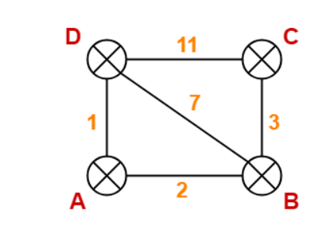
Distance Vector Routing Protocol –Example-1
Destination | Distance | Next Hop
A | 0 | A
B | 2 | B
C | ∞ | –
D | 1 | D
Destination | Distance | Next Hop
A | 2 | A
B | 0 | B
C | 3 | C
D | 7 | D
Destination | Distance | Next Hop
A | 1 | A
B | 3 | A
C | 6 | A
D | 0 | D
Destination | Distance | Next Hop
A | ∞ | –
B | 3 | B
C | 0 | C
D | 11 | D
Destination | Distance | Next Hop
A | 1 | A
B | 7 | B
C | 11 | C
D | 0 | D
Final – D Router table

Slide 5
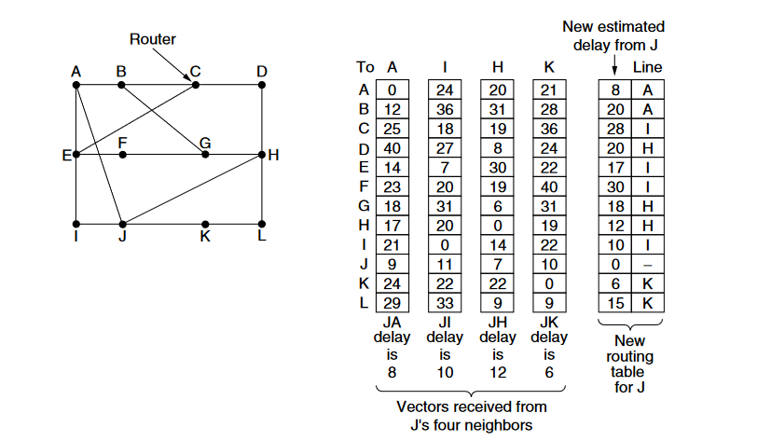
Distance Vector Routing-Example2
The first four columns of part show the delay vectors received from the neighbours of router J.
A claims to have a 12-msec delay to B, a 25-msec delay to C, a 40-msec delay to D, etc.
Suppose that J has measured or estimated its delay to its neighbours, A, I, H, and K, as 8, 10, 12, and 6 msec, respectively.
Consider how J computes its new route to router G. It knows that it can get to A in 8 msec, and furthermore A claims to be able to get to G in 18 msec, so J knows it can count on a delay of 26 msec to G if it forwards packets bound for G o A.
Similarly, it computes the delay to G via I, H, and K as 41 (31 + 10), 18(6 + 12), and 37 (31 + 6) msec, respectively.
The best of these values is 18, so it makes an entry in its routing table that the delay to G is 18 msec and that the route to use is via H. The same calculation is performed for all the other destinations.

Slide 6
Distance Vector Routing Protocol -Benefits
Simplicity: The DVP algorithm is relatively simple to implement and understand, making it easy to use in small networks or in places where resources are limited.
Low overhead: The DVP requires minimal overhead, as routers only exchange information with their immediate neighbors. This makes it efficient in terms of bandwidth and processing power.
Flexibility: The DVP algorithm is flexible and can be used with different metrics, such as hop count or delay, to determine the best path.
Scalability: The Distance Vector Routing (DVP) algorithm can be easily scaled to accommodate a growing network, as new routers can simply be added to the network and the distance vectors updated accordingly.
Stability: Distance vector routing protocols are less likely to be affected by routing loops, which can be caused by changes in network topology and that can cause network instability.
Compatibility: Distance vector routing protocols such as RIP and IGRP are widely supported by router vendors and are compatible with a variety of network devices, making them an attractive option for many organizations.

Slide 7
Distance Vector Routing Protocol-Limitations
Slow convergence: DVP have slow convergence time, meaning that it takes a long time for the network to adjust to changes in topology. This can cause temporary black holes or routing loops.
Count-to-infinity problem: DVP are prone to the count-to-infinity problem, where the distance between two routers can increase indefinitely if there is a broken link. This can make the network unreliable.
Limited scalability: DVP are unsuitable for large networks because they rely on every router knowing the entire routing table, which can lead to a high overhead.
Limited accuracy: DVP use only one metric, such as hop count, to determine the best path, which can lead to suboptimal routes.
Limited security: DVP do not have built-in security features, which can make them vulnerable to attacks.
Limited feasibility in large networks: DVP are not suitable for large networks as they rely on periodic updates from all routers, which can cause a high overhead and will not scale well.
Due to these limitations, the distance vector routing algorithm is primarily used in small networks or places, where resources are limited and more advanced routing protocols such as OSPF and EIGRP, are not feasible.

Slide 8
Counting-to-Infinity Problem
Counting-to-infinity problem- It occurs in the distance vector routing algorithm when a node receives updates about a path that has failed, and continues to use the same path in its routing table, causing the distance to increase infinitely.
The settling of routes to best paths across the network is called convergence. Distance vector routing is useful as a simple technique by which routers can collectively compute shortest paths, but it has a serious drawback in practice: all though it converges to the correct answer, it may do so slowly.
In particular, it reacts rapidly to good news, but leisurely to bad news. Consider a router whose best route to destination X is long. If, on the next exchange, neighbor A suddenly reports a short delay to X, the router just switches over to using the line to A to send traffic to X. In one vector exchange, the good news is processed.
To see how fast good news propagates, consider the five-node (linear) network, where the delay metric is the number of hops.
Suppose A is down initially and all the other routers know this. In other words, they have all recorded the delay to A as infinity.

Slide 9
Counting-to-Infinity Problem
Now let us consider the situation in which all the links and routers are initially up. Routers B, C, D, and E have distances to A of 1, 2, 3, and 4 hops, respectively.
Suddenly, either A goes down or the link between A and B is cut (which is effectively the same thing from B’s point of view).
At the first packet exchange, B does not hear anything from A. Fortunately, C says ‘‘Do not worry; I have a path to A of length 2.’’ Little does B suspect that C’ path runs through B itself. For all B knows, C might have ten links all with separate paths to A of length 2.
As a result, B thinks it can reach A via C, with a path length of 3. D and E do not update their entries for A on the first exchange.
On the second exchange, C notices that each of its neighbors claims to have a path to A of length 3. It picks one of them at random and makes its new distance to A as shown in the third row.

Slide 10
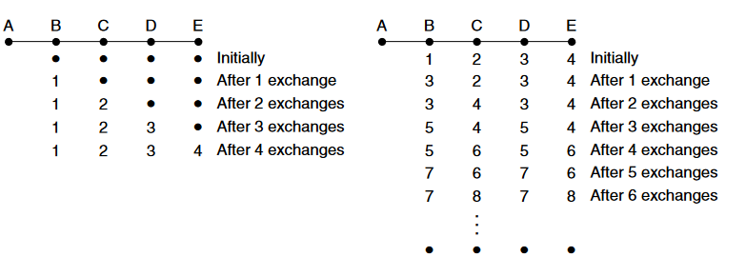
Counting-to-Infinity Problem

Slide 11
Counting-to-Infinity Problem
When A comes up, the other routers learn about it via the vector exchanges. For simplicity, we will assume that there is a gigantic gong somewhere that is struck periodically to initiate a vector exchange at all routers simultaneously.
At the time of the first exchange, B learns that its left-hand neighbor has zero delay to A.
B now makes an entry in its routing table indicating that A is one hop away to the left.
All the other routers still think that A is down. At this point, the routing table entries for A are as shown in the second row.
On the next exchange, C learns that B has a path of length 1 to A, so it updates its routing table to indicate a path of length 2, but D and E do not hear the good news until later.
Clearly, the good news is spreading at the rate of one hop per exchange. In a network whose longest path is of length N hops, within N exchanges everyone will know about newly revived links and routers.

Slide 12
Counting-to-Infinity Problem
Subsequent exchanges produce the history shown in the rest of the figure should be clear why bad news travels slowly: no router ever has a value more than one higher than the minimum of all its neighbors.
Gradually, all routers work their way up to infinity, but the number of exchanges required depends on the numerical value used for infinity.
For this reason, it is wise to set infinity to the longest path plus 1.
Counting-to-infinity problem can be prevented in the distance vector algorithm by using techniques such as Route poisoning and Triggered updates.
The split horizon with poisoned reverse rule discussed in RFC 1058.

